Slide 1
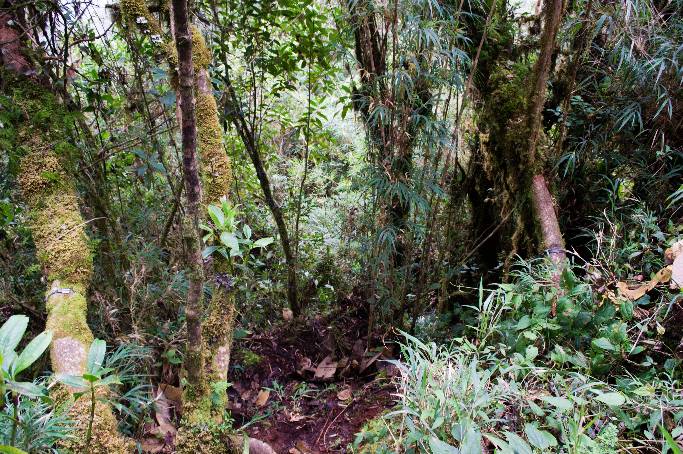

Improving the accuracy of elevational range shift models
John Godlee
12th May 2016

Slide 2




Climate change & range shifts
Climate
change
Morphology
Guerin et al. 2012
Adaptation
Acclimation
Phenology
Richardson et al. 2013
Physiology
Hoffmann & Śgro 2011
Spatially dependent mortality/recruitment
Elevation
Range shifts
Latitude
Chen et al. 2011

Slide 3
Bioclimatic envelope models
Current species distribution
Climate data
Bioclimatic envelope
Climate predictions
Predicted species range
Pearson & Dawson
2003

Slide 4
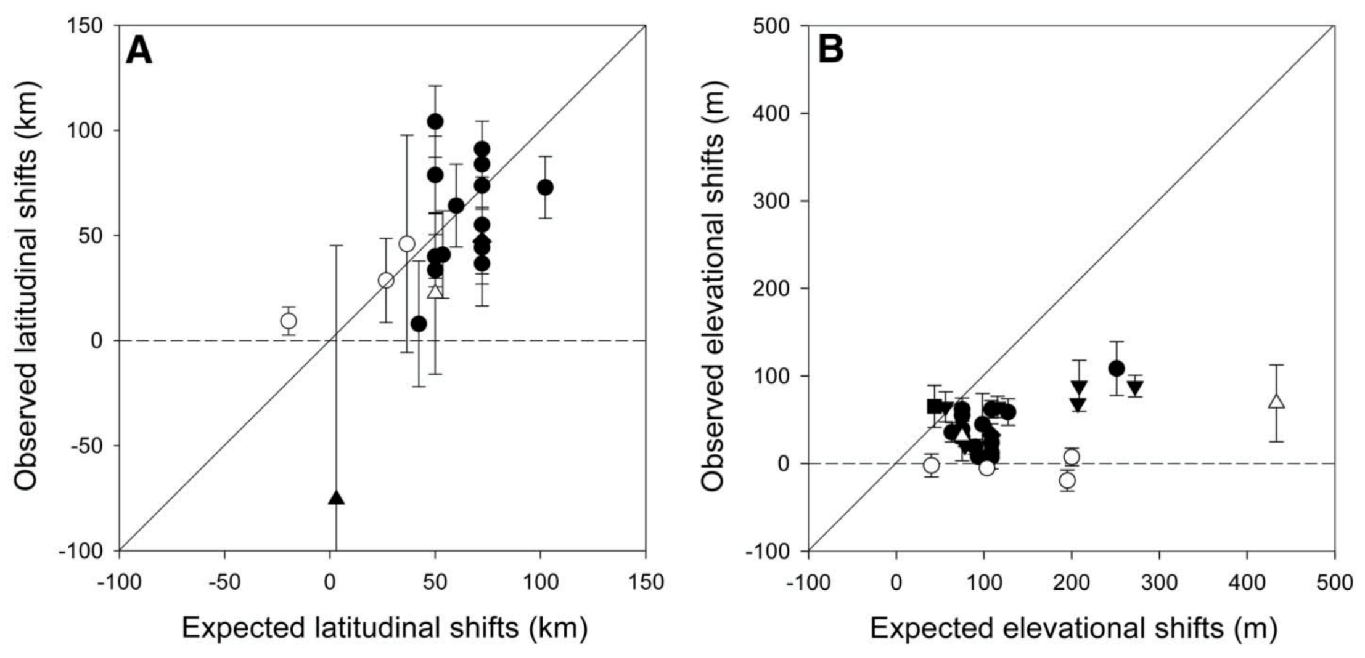
Models fail to predict elevation shifts
Mean range shift ± 1 S.E.
Latitudinal Range Shifts
Elevational Range Shifts
Birds
Arthropods
Mammals
Molluscs
Plants
Herptiles
Fish
Chen et al. 2011

Slide 5


Competitive Interactions
Other variables change with elevation
Nutrient Availability
Elevation
Low
High
Herbivory
Whitaker et al. 2014,
Nottingham et al. 2015

Slide 6
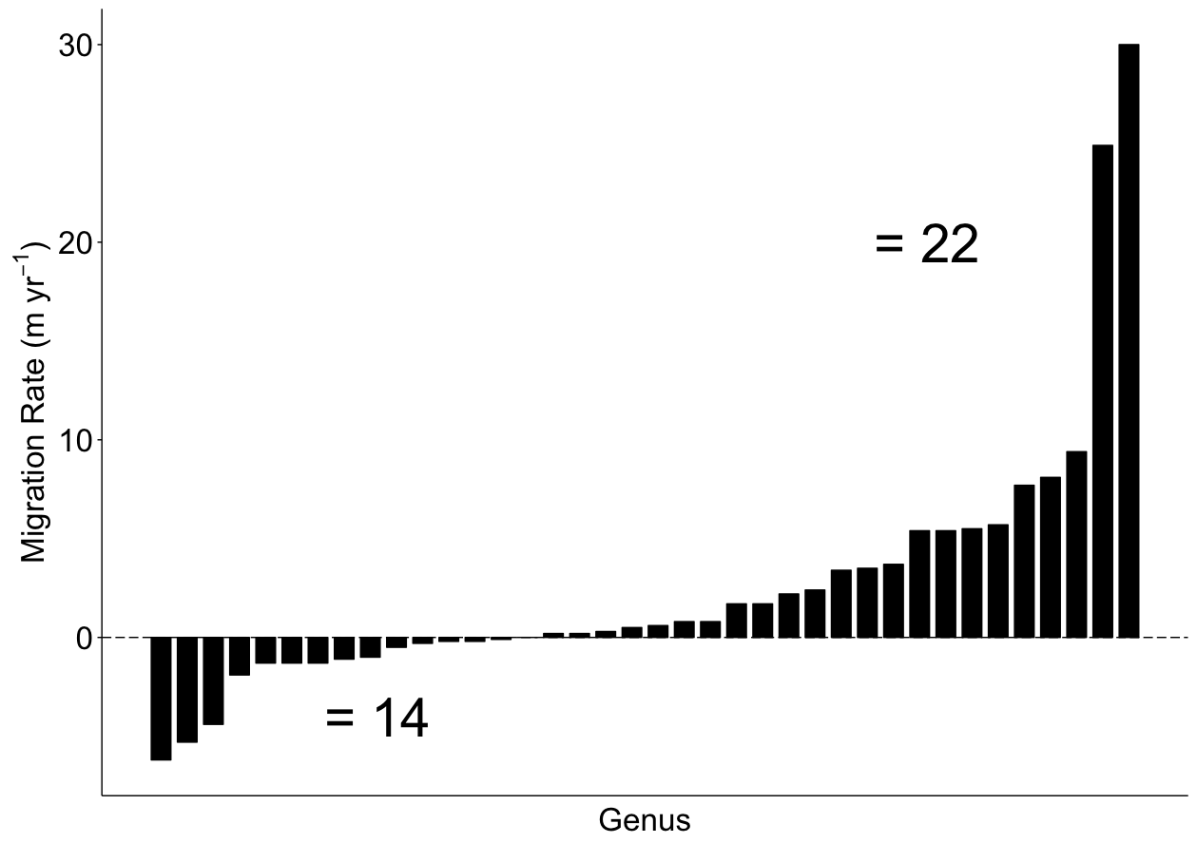
Species differ in their climate sensitivity
Data from:
Feeley et al. 2011

Slide 7
Research questions
Do competition variables explain variation in plant stress variables?
Should competition effects be included in future range shift models?
Do species differ in their sensitivity to variation in elevationally dependent environmental variables
Should each species be treated separately in future models?

Slide 8
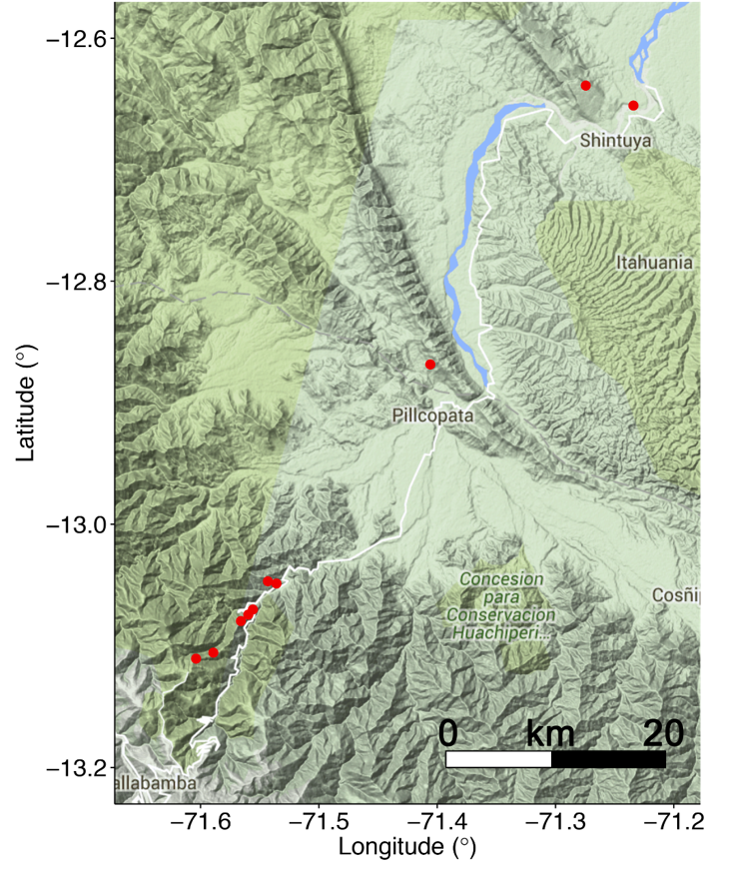
Study site
400 m
Plot
3200 m

Slide 9
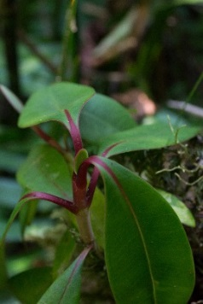
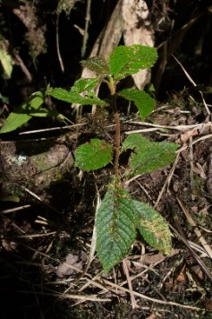
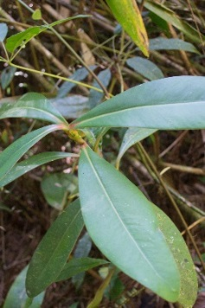
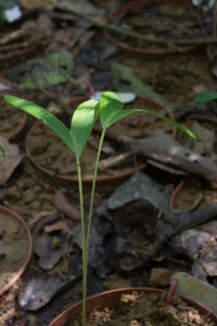
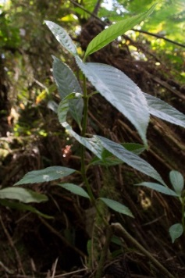
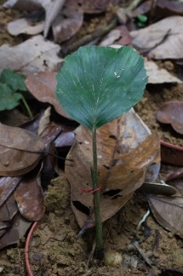
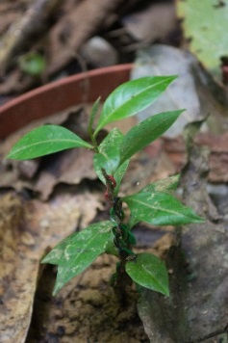
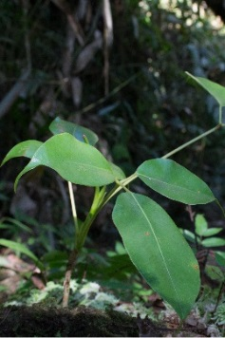
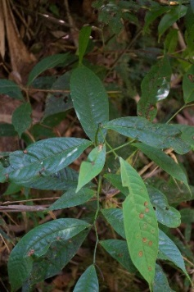
Study species
Range Limits
Upper
Middle
Lower
Sample
Site
Alzatea verticillata
Clethra
revoluta
Clusia
thurifera
Dictyocaryum
lamarckianum
Hedyosmum
goudotianum
Iriartea
deltoidea
Myrcia
spp.
Schefflera
patula
Tapirira
guianensis

Slide 10
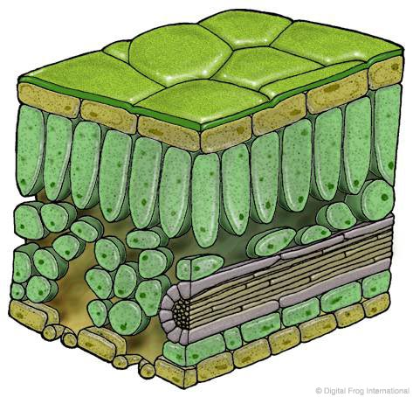
Stress – Chlorophyll fluorescence & content
Healthy Plant – photosynthetic efficiency (F_{v}/F_{m}) ~ 0.8
Chlorophyll fluorescence
Light
Heat
PSII
Photosynthesis
Chlorophyll fluorescence using a
MINI-PAM-II fluorometer

Slide 11
Stress – Chlorophyll fluorescence & content
Stressed Plant – photosynthetic efficiency (F_{v}/F_{m}) < 0.7
Chlorophyll fluorescence
Light
Heat
PSII
Chlorophyll fluorescence using a
MINI-PAM-II fluorometer

Slide 12
Competition interactions
Canopy Density
Adult-Seedlings Competition
Canopy Density
Root Competition
Seedling-Seedling Competition
Seedling Abundance
Seedling
Abundance
Root
Competition

Slide 13
Statistical analysis – effect of competition
Response
Fixed Effect
Random Effects
~
Elevation
Root Competition
Canopy Density
Seedling Abundance
+ (Plot) + (Species)
Photosynthetic Efficiency
Chlorophyll Content
AIC and R2 to choose between models

Slide 14
Statistical analysis – effect of competition
Response
Fixed Effects
Random Effects
~
+
+
+
+ (Plot) + (Species)
Best quality model chosen using:
AIC (Akaike Information Criterion)
Pseudo-R-squared (Barton 2015)
Model validation using:
Variance Inflation Factors
Heteroscedasticity –
predicted vs. observed plot

Slide 15
Statistical analysis – species sensitivity
Response
Fixed Effect
Random Effects
~
+ (Plot) + (Elevation|Species)

Slide 16
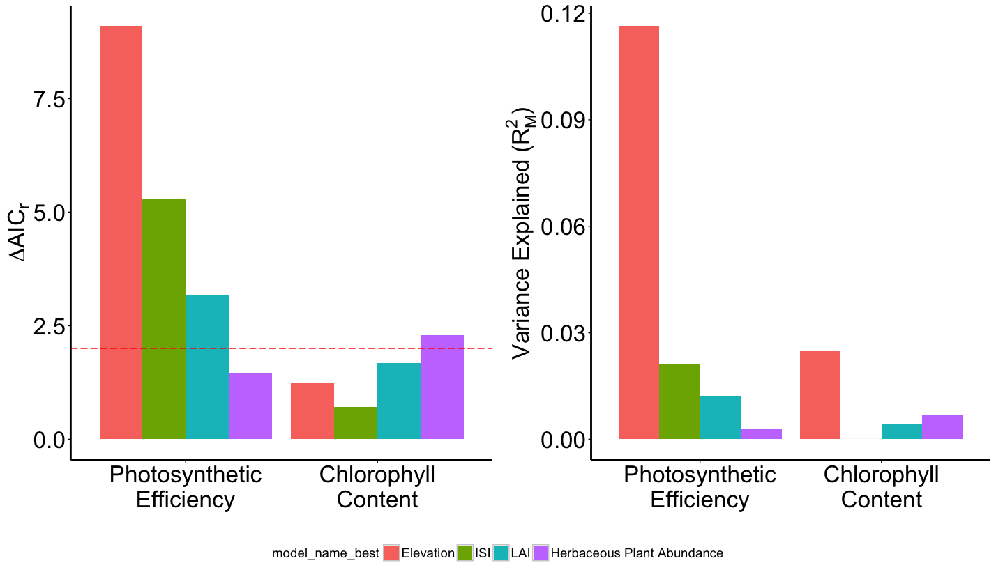
Results – effect of competition
Fixed Effect
Elevation
Root Comp.
Canopy Density
Seedling Abundance
ΔAIC_{r} = 2

Slide 17
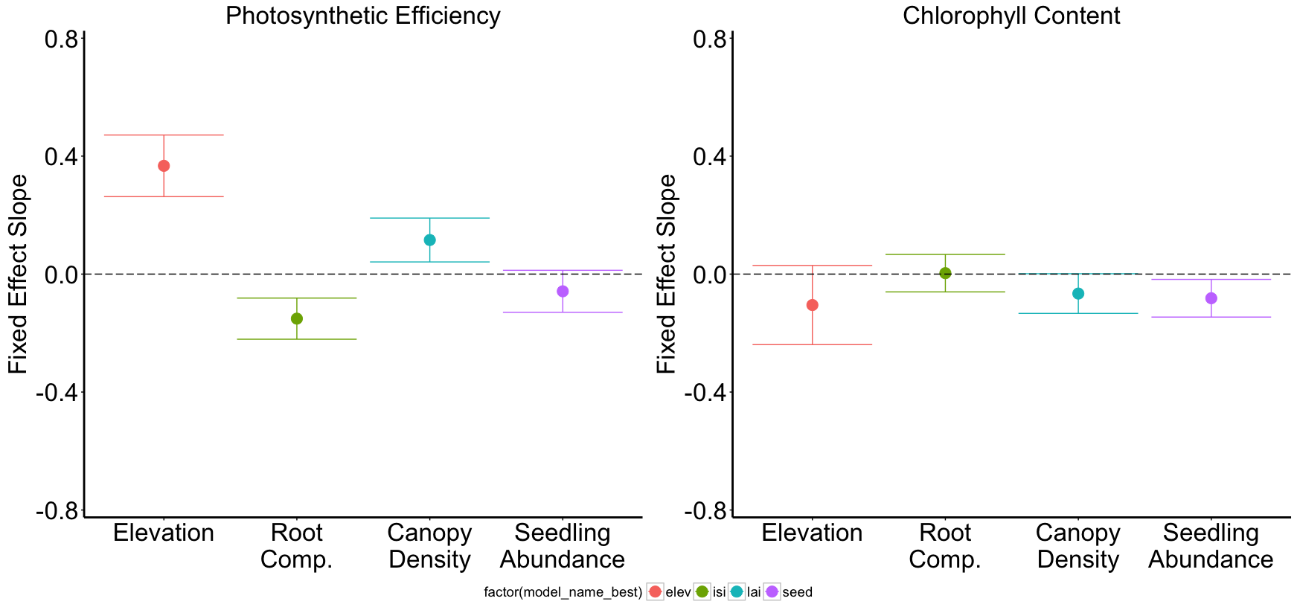

Results – effect of competition
Slope ±
1 S.E.

Slide 18
Results – Best Model
Response
Fixed Effects
Random Effects
Photosynthetic
Efficiency
~
+
+
+ (Plot) + (Species)
Chlorophyll Content
~
+ (Plot) + (Species)

Slide 19
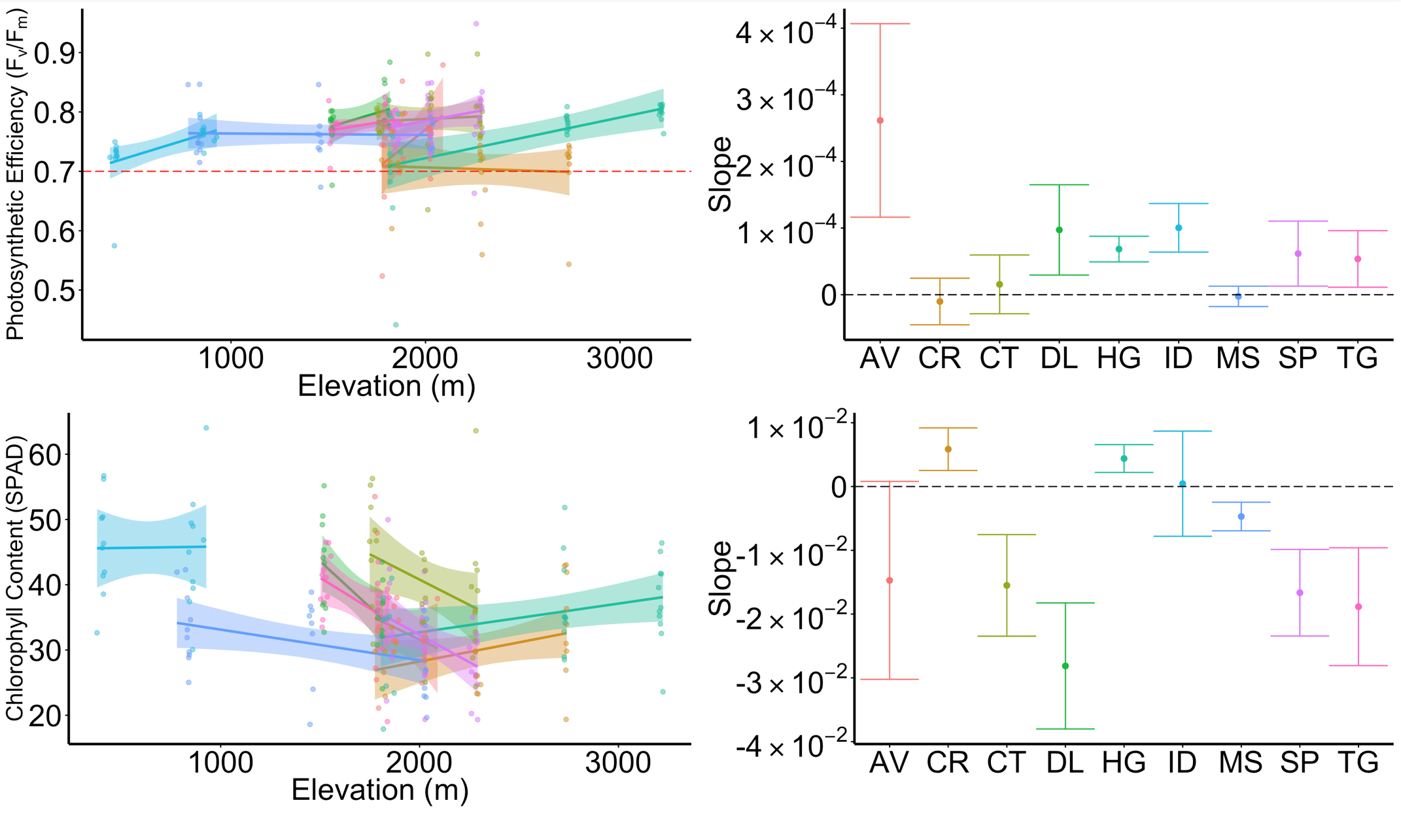

Results – Species sensitivity
Regression ± 95% Confidence Interval
Slope ± 1 S.E.

Slide 20


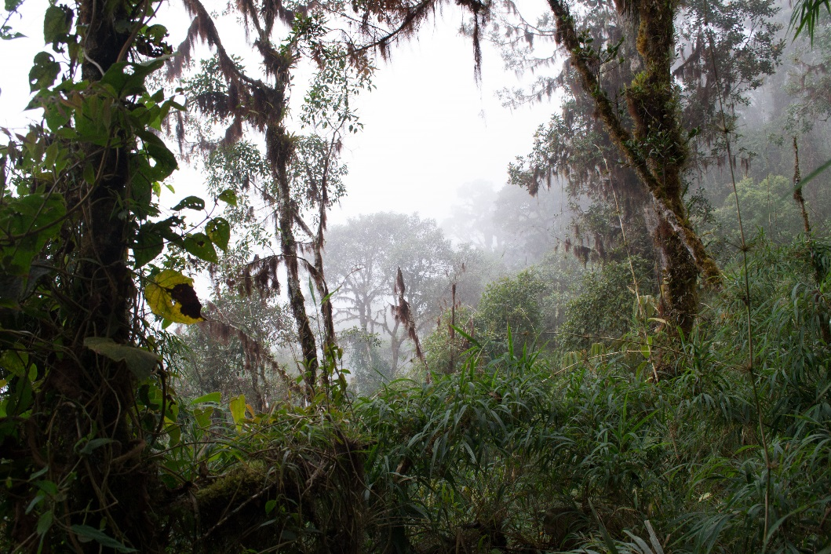
Limitations
Only investigated seedlings
Adult trees react differently (Larcher 2003)
Only investigated nine common species
Rare species react differently (Lyons et al. 2005, Mouillot et al. 2013)
Correlation ≠ Causation
≠

Slide 21
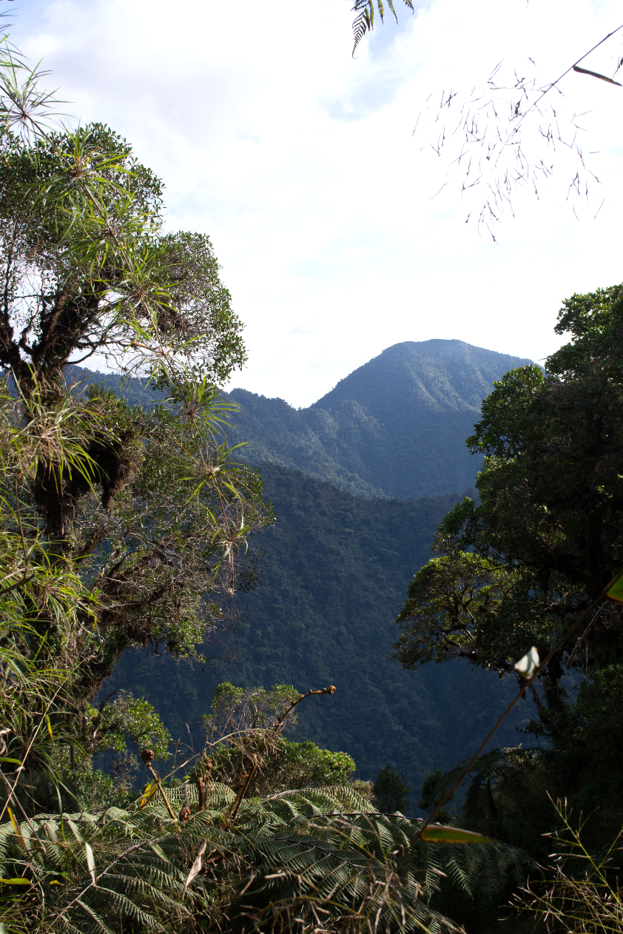
Future Studies
Experimental studies to take individuals out of their current ranges.
Does stress translate to mortality, recruitment?
Similar studies in other understudied biomes.

Slide 22
Summary
Adult-seedling competition interactions have an effect on seedling stress levels
No competition interactions had a greater effect than elevation
Chlorophyll content does not vary meaningfully with any measured variable
Photosynthetic efficiency was best predicted using a model incorporating elevation and adult-seedling competition effects.

Slide 23
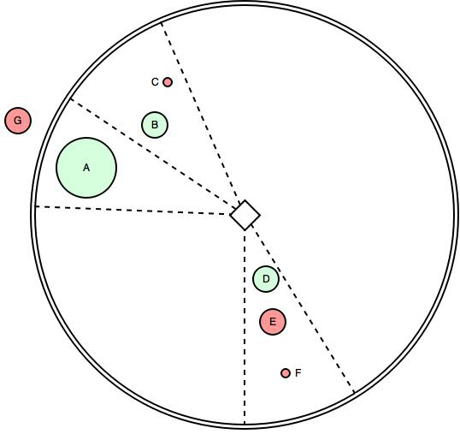
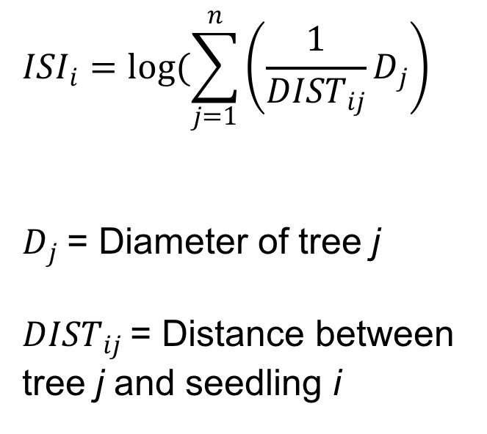
Root Competition – Iterative Seedling Index
$${ISI}_{i}=log(\sum_{j=1}^{n}{\left(\frac{1}{{DIST}_{ij}}D_{j}\right)}$$
$D_{j}$= Diameter of tree j
${DIST}_{ij}$= Distance between
tree j and seedling i
Active competitor
Inactive competitor
Seedling
30° zone
Adapted from:
Hegyi 1974

Slide 24
References
Barton K. (2015). MuMIn: Multi-Model Inference. http://CRAN.R-project.org/package=MuMIn.
Chen I.-C., Hill J. K., Ohlemuller R., Roy D. B., & Thomas C. D. (2011). Rapid range shifts of species associated with high levels of climate warming. Science, 333(6045), 1024–1026.
Feeley K. J., Silman M. R., Bush M. B., Farfan W., Cabrera K. G., Malhi Y., … Saatchi S. (2011). Upslope migration of Andean trees. Journal of Biogeography, 38, 783–791.
Guerin G. R., Wen H., & Lowe a. J. (2012). Leaf morphology shift linked to climate change. Biology Letters, 8(5), 882–886.
Hegyi F. (1974). A simulation model for managing jack-pine stands. In Growth models for tree and stand simulation (pp. 74–90).
Hoffmann A., & Sgrò C. (2011). Climate change and evolutionary adaptation. Nature, 470(7335), 479–485.
Larcher W. (2003). Physiological Plant Ecology: Ecophysiology and Stress Physiology of Functional Groups (4th ed.). Berlin: Springer-Verlag.
Mouillot D., Bellwood D. R., Baraloto C., Chave J., Galzin R., Harmelin-Vivien M., … Thuiller W. (2013). Rare Species Support Vulnerable Functions in High-Diversity Ecosystems. PLoS Biology, 11(5).
Nottingham A. T., Turner B. L., Whitaker J., Ostle N., McNamara N. P., Bardgett R. D., … Meir P. (2015). Soil microbial nutrient constraints along a tropical forest elevation gradient: a belowground test of a biogeochemical paradigm. Biogeosciences Discussions, 12(8), 6489–6523.
Pearson R. G., & Dawson T. P. (2003). Predicting the impacts of climate change on the distribution of speces: are bioclimate envelope models useful? Global Ecology and Biogeography, 12, 361–371.
Whitaker J., Ostle N., Nottingham A. T., Ccahuana A., Salinas N., Bardgett R. D., … McNamara N. P. (2014). Microbial community composition explains soil respiration responses to changing carbon inputs along an Andes-to-Amazon elevation gradient. Journal of Ecology, 102(4), 1058–1071.
All photographs by John Godlee. All illustrations used under a Creative Commons BY-NC license.

